Slide 1

Note: The data and information in this document is reflective of a hypothetical situation and client. This document is to be used for KPMG Virtual Internship purposes only.
Sprocket Central Pty Ltd
Data analytics approach
[Division Name] - [Engagement Manager], [Senior Consultant], [Junior Consultant]

Slide 2
Note: The data and information in this document is reflective of a hypothetical situation and client. This document is to be used for KPMG Virtual Internship purposes only.
Agenda
Introduction
Data Exploration
Model Development
Interpretation

Slide 3
Note: The data and information in this document is reflective of a hypothetical situation and client. This document is to be used for KPMG Virtual Internship purposes only.
Introduction
Look into these factors in new customers:
Age distributions along with gender.
Number of bike purchases.
Job industry category.
Wealth segments.
Number of cars own on each states.

Slide 4
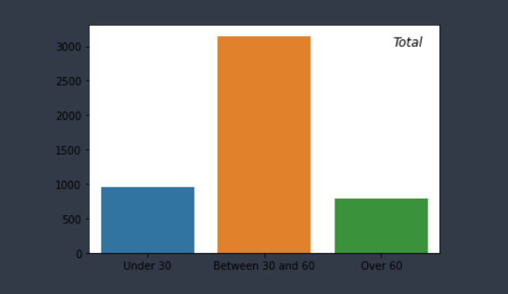
Note: The data and information in this document is reflective of a hypothetical situation and client. This document is to be used for KPMG Virtual Internship purposes only.
Data Exploration
Customers’ age distribution
As seen here, mostly our new customers are recommended between 30 to 60 years old.
Number of customers above 60 old has big diminution again.
It looks like the percentages of under 30 years old not really change but are more than 60 years old in number.

Slide 5
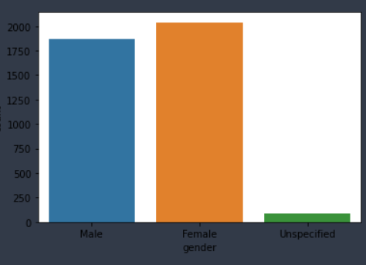
Bike purchases by gender
As we can see, our new customers mostly Female with 50.98% purchases
Male contributed to 46.82% purchases
So we should focus on advertises on Female customers than Male customers

Slide 6
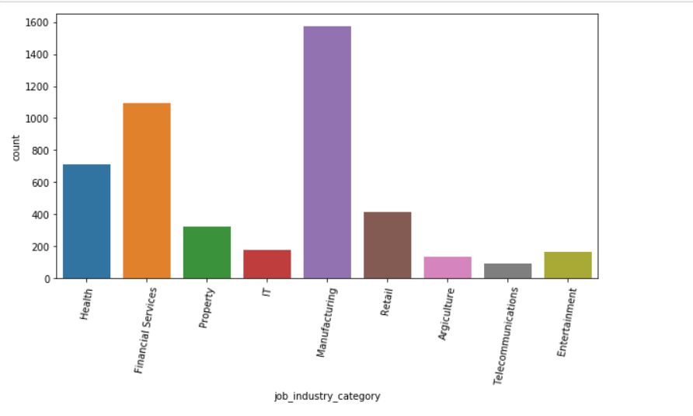
Job industry category.
Mostly our new customers are on Finance industry and our Manufacturing customers are still on top 2.
The rest industries is still same

Slide 7
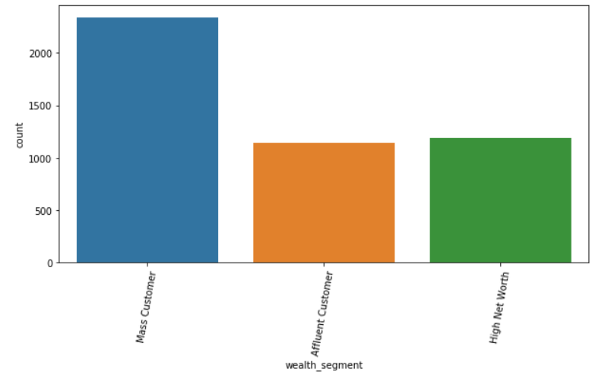
Wealth Segment
In all ages, the number of Mass Customers is the highest so we should focus on this social class.
After that, we should focus on High Net Customer.
Then Affluent Customers but mostly second and third quadrant.

Slide 8
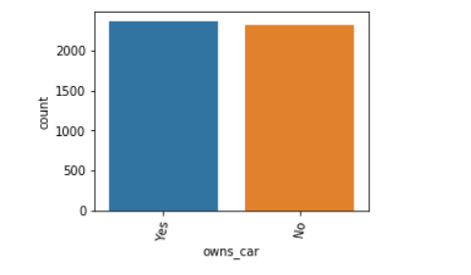
No. of cars own
NSW should be considered the most since numbers of customers don’t own cars is significantly larger than that own.
VIC and QLD has more customers that own car that who don’t but we can try to have something so that those owns car will buy bikes.

